Slide 1


Control Systems (CS)
Lecture-10-11
Signal Flow Graphs
Dr. Imtiaz Hussain
Associate Professor
Mehran University of Engineering & Technology Jamshoro, Pakistan
email: imtiaz.hussain@faculty.muet.edu.pk
URL :http://imtiazhussainkalwar.weebly.com/

Slide 2
Outline
Introduction to Signal Flow Graphs
Definitions
Terminologies
Examples
Mason’s Gain Formula
Examples
Signal Flow Graph from Block Diagrams
Design Examples

Slide 3
Introduction
Alternative method to block diagram representation, developed by Samuel Jefferson Mason.
Advantage: the availability of a flow graph gain formula, also called Mason’s gain formula.
A signal-flow graph consists of a network in which nodes are connected by directed branches.
It depicts the flow of signals from one point of a system to another and gives the relationships among the signals.

Slide 4
Fundamentals of Signal Flow Graphs
Consider a simple equation below and draw its signal flow graph:
The signal flow graph of the equation is shown below;
Every variable in a signal flow graph is designed by a Node.
Every transmission function in a signal flow graph is designed by a Branch.
Branches are always unidirectional.
The arrow in the branch denotes the direction of the signal flow.

Slide 5
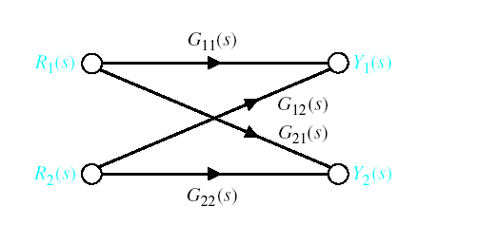
Signal-Flow Graph Models

Slide 6
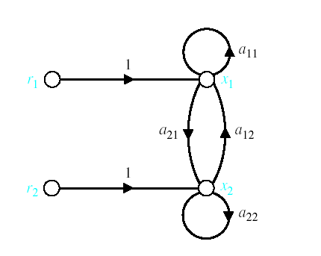
Signal-Flow Graph Models
r₁ and r₂ are inputs and x₁ and x₂ are outputs

Slide 7
Signal-Flow Graph Models
x_{o} is input and x₄ is output
f
c
x₀
x₁
x₂
g
x₃
x₄
a
d
h
b
e

Slide 8
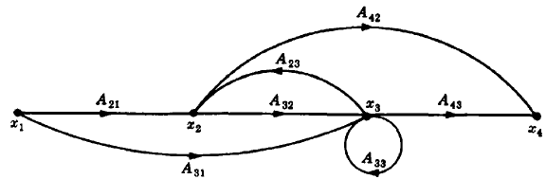
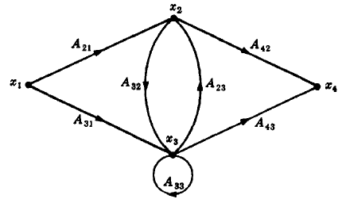
Construct the signal flow graph for the following set of simultaneous equations.
There are four variables in the equations (i.e., x₁,x₂,x₃,and x₄) therefore four nodes are required to construct the signal flow graph.
Arrange these four nodes from left to right and connect them with the associated branches.
Another way to arrange this graph is shown in the figure.

Slide 9
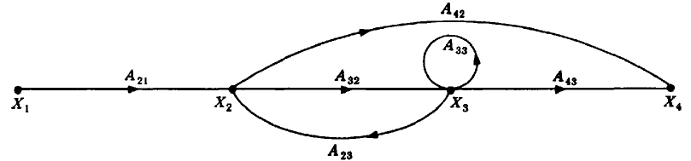
Terminologies
An input node or source contain only the outgoing branches. i.e., X₁
An output node or sink contain only the incoming branches. i.e., X₄
A path is a continuous, unidirectional succession of branches along which no node is passed more than ones. i.e.,
A forward path is a path from the input node to the output node. i.e.,
X₁ to X₂ to X₃ to X₄ , and X₁ to X₂ to X₄ , are forward paths.
A feedback path or feedback loop is a path which originates and terminates on the same node. i.e.; X₂ to X₃ and back to X₂ is a feedback path.
X₁ to X₂ to X₃ to X₄
X₁ to X₂ to X₄
X₂ to X₃ to X₄

Slide 10
Terminologies
A self-loop is a feedback loop consisting of a single branch. i.e.; A₃₃ is a self loop.
The gain of a branch is the transmission function of that branch.
The path gain is the product of branch gains encountered in traversing a path. i.e. the gain of forwards path X₁ to X₂ to X₃ to X₄ is A₂₁A₃₂A₄₃
The loop gain is the product of the branch gains of the loop. i.e., the loop gain of the feedback loop from X₂ to X₃ and back to X₂ is A₃₂A_{23.}
Two loops, paths, or loop and a path are said to be non-touching if they have no nodes in common.

Slide 11
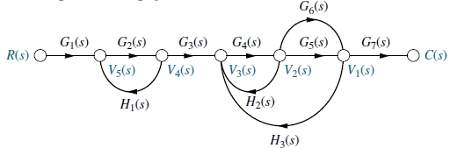
Consider the signal flow graph below and identify the following
Input node.
Output node.
Forward paths.
Feedback paths (loops).
Determine the loop gains of the feedback loops.
Determine the path gains of the forward paths.
Non-touching loops

Slide 12

Consider the signal flow graph below and identify the following
There are two forward path gains;

Slide 13
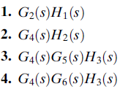
Consider the signal flow graph below and identify the following
There are four loops

Slide 14

Consider the signal flow graph below and identify the following
Nontouching loop gains;

Slide 15
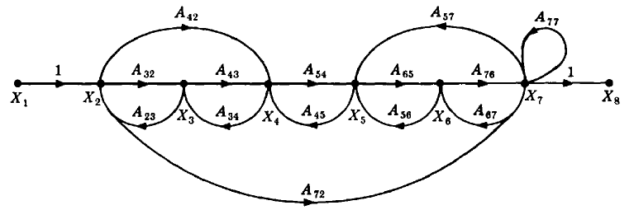
Consider the signal flow graph below and identify the following
Input node.
Output node.
Forward paths.
Feedback paths.
Self loop.
Determine the loop gains of the feedback loops.
Determine the path gains of the forward paths.

Slide 16
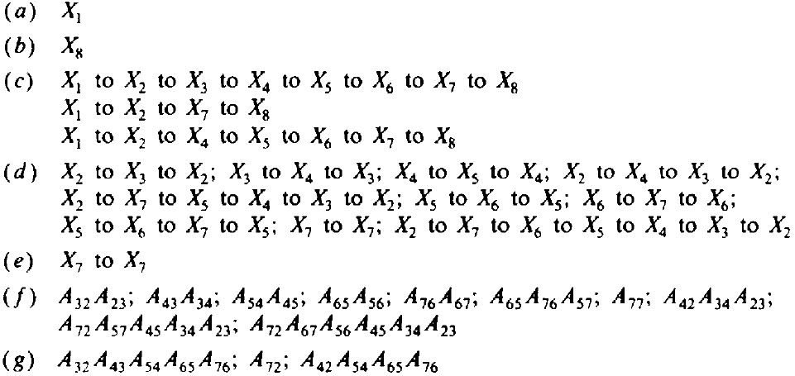
Input and output Nodes
Input node
Output node

Slide 17
(c) Forward Paths

Slide 18
(d) Feedback Paths or Loops

Slide 19
(d) Feedback Paths or Loops

Slide 20
(d) Feedback Paths or Loops

Slide 21
(d) Feedback Paths or Loops

Slide 22
(e) Self Loop(s)

Slide 23
(f) Loop Gains of the Feedback Loops

Slide 24
(g) Path Gains of the Forward Paths

Slide 25
Mason’s Rule (Mason, 1953)
The block diagram reduction technique requires successive application of fundamental relationships in order to arrive at the system transfer function.
On the other hand, Mason’s rule for reducing a signal-flow graph to a single transfer function requires the application of one formula.
The formula was derived by S. J. Mason when he related the signal-flow graph to the simultaneous equations that can be written from the graph.

Slide 26
Mason’s Rule:
The transfer function, C(s)/R(s), of a system represented by a signal-flow graph is;
Where
n = number of forward paths.
P_{i} = the i ^{th} forward-path gain.
∆ = Determinant of the system
∆_{i} = Determinant of the i^{th} forward path
∆ is called the signal flow graph determinant or characteristic function. Since ∆=0 is the system characteristic equation.

Slide 27
Mason’s Rule:
∆ = 1- (sum of all individual loop gains) + (sum of the products of the gains of all possible two loops that do not touch each other) – (sum of the products of the gains of all possible three loops that do not touch each other) + … and so forth with sums of higher number of non-touching loop gains
∆_{i} = value of Δ for the part of the block diagram that does not touch the i-th forward path (Δ_{i} = 1 if there are no non-touching loops to the i-th path.)

Slide 28
Systematic approach
Calculate forward path gain P_{i} for each forward path i.
Calculate all loop transfer functions
Consider non-touching loops 2 at a time
Consider non-touching loops 3 at a time
etc
Calculate Δ from steps 2,3,4 and 5
Calculate Δ_{i} as portion of Δ not touching forward path i

Slide 29
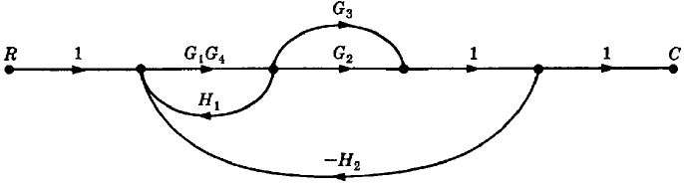

Example#1: Apply Mason’s Rule to calculate the transfer function of the system represented by following Signal Flow Graph
Therefore,
There are three feedback loops

Slide 30
Example#1: Apply Mason’s Rule to calculate the transfer function of the system represented by following Signal Flow Graph
There are no non-touching loops, therefore
∆ = 1- (sum of all individual loop gains)

Slide 31
Example#1: Apply Mason’s Rule to calculate the transfer function of the system represented by following Signal Flow Graph
Eliminate forward path-1
∆₁ = 1- (sum of all individual loop gains)+...
∆₁ = 1
Eliminate forward path-2
∆₂ = 1- (sum of all individual loop gains)+...
∆₂ = 1

Slide 32


Example#1: Continue

Slide 33
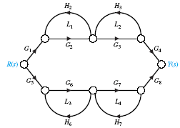
Example#2: Apply Mason’s Rule to calculate the transfer function of the system represented by following Signal Flow Graph
P₁
P₂
1. Calculate forward path gains for each forward path.
2. Calculate all loop gains.
3. Consider two non-touching loops.
L₁L₃ L₁L₄
L₂L₄ L₂L₃

Slide 34
Example#2: continue
Consider three non-touching loops.
None.
Calculate Δ from steps 2,3,4.

Slide 35
Example#2: continue
Eliminate forward path-1
Eliminate forward path-2

Slide 36
Example#2: continue

Slide 37
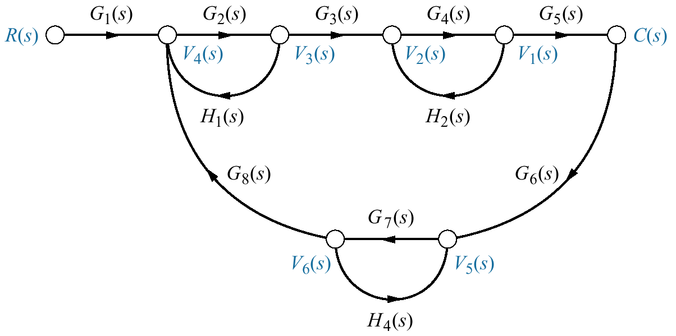
Example#3
Find the transfer function, C(s)/R(s), for the signal-flow graph in figure below.

Slide 38

Example#3
There is only one forward Path.

Slide 39
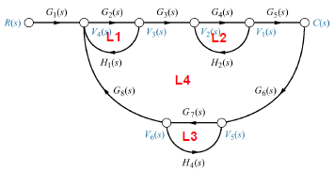

Example#3
There are four feedback loops.

Slide 40

Example#3
Non-touching loops taken two at a time.

Slide 41
Example#3
Non-touching loops taken three at a time.

Slide 42
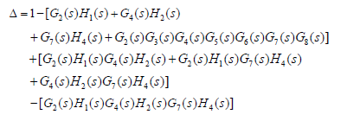
Example#3
Eliminate forward path-1

Slide 43
Example#4: Apply Mason’s Rule to calculate the transfer function of the system represented by following Signal Flow Graph
There are three forward paths, therefore n=3.

Slide 44
Example#4: Forward Paths

Slide 45
Example#4: Loop Gains of the Feedback Loops

Slide 46
Example#4: two non-touching loops

Slide 47
Example#4: Three non-touching loops

Slide 48
From Block Diagram to Signal-Flow Graph Models Example#5
H₁
R(s)
E(s)
X₁
－
X₃
C(s)
G₁
G₂
G₃
G₄
－
X₂
－
H₂
H₃
－H₁
R(s)
1
E(s)
G₁
X₁
G₂
X₂
G₃
X₃
G₄
C(s)
－H₂
－H₃

Slide 49
From Block Diagram to Signal-Flow Graph Models Example#5
－H₁
R(s)
1
E(s)
G₁
X₁
G₂
X₂
G₃
G₄
X₃
1
C(s)
－H₂
－H₃

Slide 50
Example#6
－
X₁
Y₁
－
G₁
R(s)
E(s)
+
+
C(s)
－
－
+
X₂
G₂
－
Y₂
-1
X₁
G₁
Y₁
-1
1
R(s)
E(s)
-1
C(s)
1
1
1
1
X₂
G₂
Y₂
-1
-1

Slide 51
Example#6
-1
X₁
G₁
Y₁
-1
1
R(s)
1
E(s)
-1
C(s)
1
X₂
1
Y₂
1
G₂
-1
-1
7 loops:
3 ‘2 non-touching loops’ :

Slide 52
Example#6
-1
X₁
G₁
Y₁
-1
1
R(s)
1
E(s)
-1
C(s)
1
X₂
1
Y₂
1
G₂
-1
-1
Then:
4 forward paths:

Slide 53
Example#6
We have

Slide 54
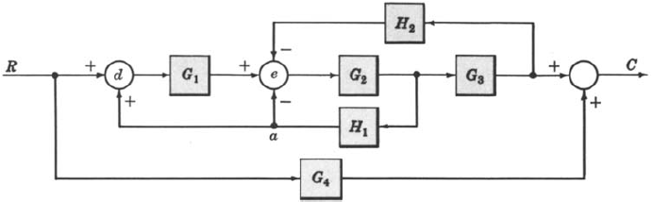
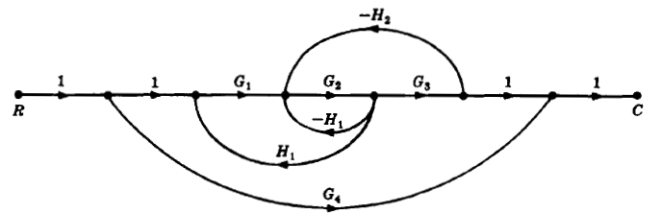

Example-7: Determine the transfer function C/R for the block diagram below by signal flow graph techniques.
The signal flow graph of the above block diagram is shown below.
There are two forward paths. The path gains are
The three feedback loop gains are
No loops are non-touching, hence
Because the loops touch the nodes of P1, hence
Hence the control ratio T = C/R is
Since no loops touch the nodes of P2, therefore

Slide 55
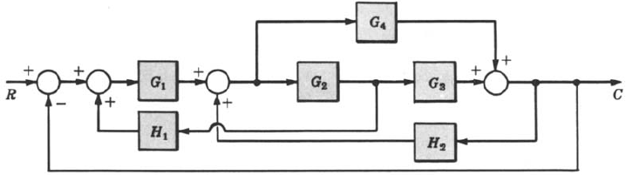
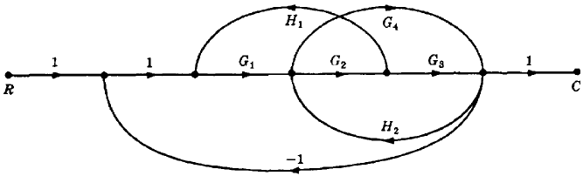

Example-6: Find the control ratio C/R for the system given below.
The signal flow graph is shown in the figure.
The two forward path gains are
The five feedback loop gains are
There are no non-touching loops, hence
All feedback loops touches the two forward paths, hence
Hence the control ratio T =

Slide 56
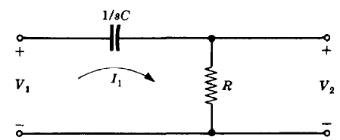
Design Example#1

Slide 57
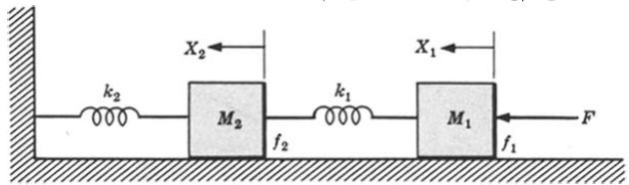

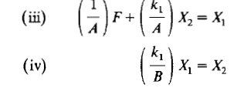
Design Example#2

Slide 58
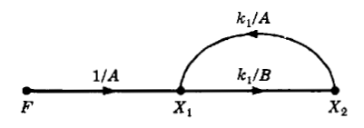
Design Example#2

Slide 59
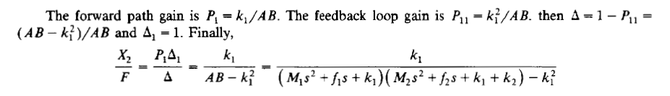
Design Example#2

Slide 60
End of Lectures-10-11
To download this lecture visit
http://imtiazhussainkalwar.weebly.com/

